Slide 1

Chapter 5 – Clustering
Prepared by: Shier Nee, SAW

Slide 2
Outline
Background
Clustering algorithms
K-mean
EM Clustering
Hierarchy

Slide 3
Clustering
Unsupervised Learning
No Ground Truth
Investigate data structure by grouping them into distinct groups.
Advantage: useful when don’t know what to look for
Disadvantage: Subjective

Slide 4
Applications
Find set of representative that provide coverage of the data
Identify fake news based on the content
Group emails
Exploratory Insight
Customer shopping patterns
Groups of genes/proteins with similar function
Notes:
Uni – 45 min, multi – 30min, break (15min), statistic – 1.5hr

Slide 5
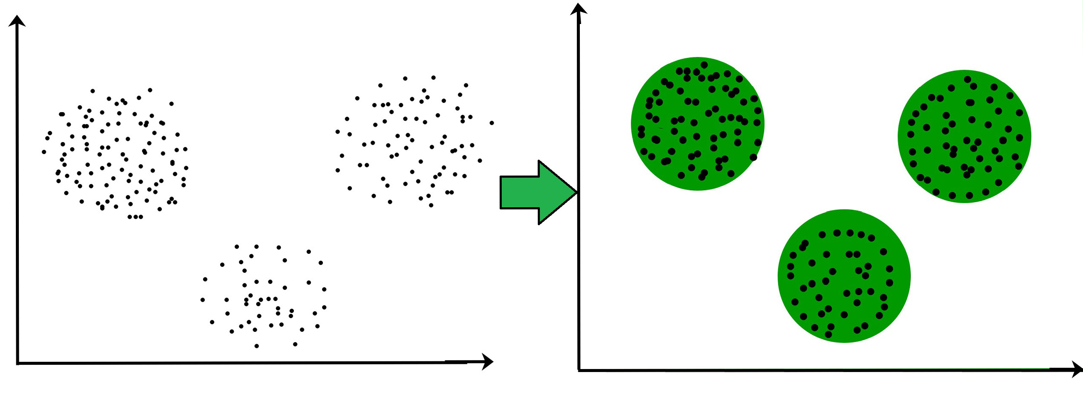
Clustering
Basic idea: group similar instances together
Example: 2D point patterns
Image taken from https://www.geeksforgeeks.org/clustering-in-machine-learning/
Notes:
Uni – 45 min, multi – 30min, break (15min), statistic – 1.5hr

Slide 6
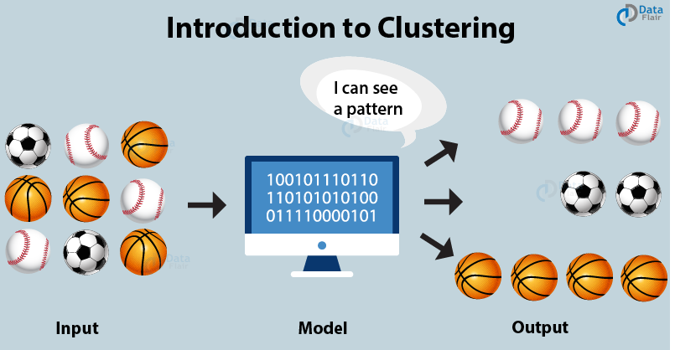
Clustering
Basic idea: group similar instances together
Example: Image
Image taken from https://data-flair.training/blogs/clustering-in-machine-learning/
Notes:
Uni – 45 min, multi – 30min, break (15min), statistic – 1.5hr

Slide 7
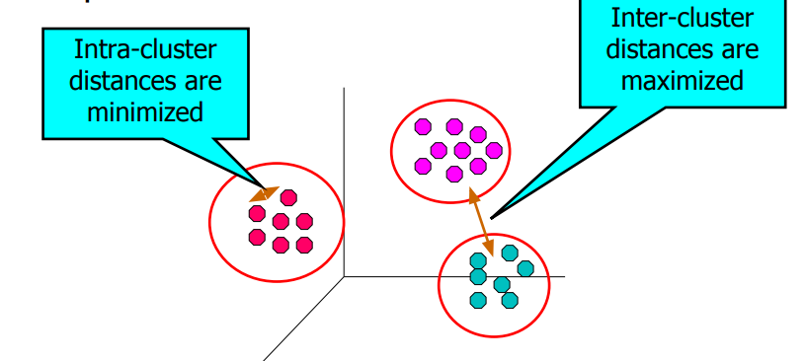
Clustering
Basic idea: group similar instances together
What does “similar” mean?
Based on Euclidean distance (squared), or
Measure of similarity (or distance) between “points” to be clustered
Notes:
Uni – 45 min, multi – 30min, break (15min), statistic – 1.5hr

Slide 8
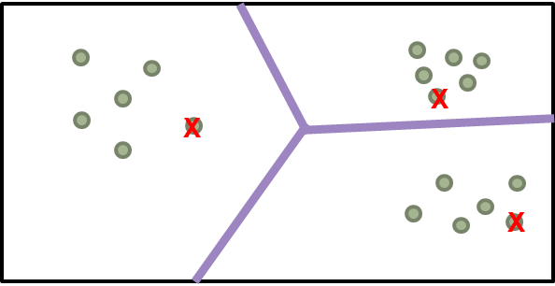
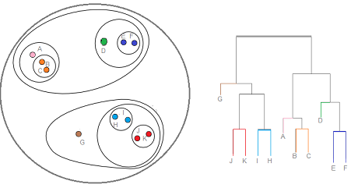
Clustering
Partitional - data in non-overlapping subsets. One data object is in one subset
Hierarchy - data are in nested clusters, organized in a hierarchical tree
Partitional
Hierarchy
Notes:
Uni – 45 min, multi – 30min, break (15min), statistic – 1.5hr

Slide 9
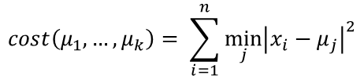
Partitional Clustering - Kmean
Also known as Lloyd’s algorithm
Input: x₁, x₂, …, x_{n} , given x ∈R^{d}
Output: ‘Centers’, μ₁, μ₂, …, μ_{k} , given μ ∈R^{d}
Goal: Minimize average square distance between point and the closest ‘center’
X
X
X
$$cost\left(μ_{1},…, μ_{k}\right)= \sum_{i=1}^{n}{\min_{j}{{\left|x_{i}−μ_{j}\right|}^{2}}}$$
Euclidean distance

Slide 10
K-mean
Say we want three clusters, first initialize random center
X
X
X
Generate optimal partition
Compute Euclidean distance between center and data points

Slide 11
K-mean
X
X
X
Update the center by computing the mean of coordinate in their respective region.

Slide 12
K-mean
X
X
X
Updated center
Compute Euclidean distance between points to the closest centers.
Identify the three regions

Slide 13
K-mean
X
X
X
Center no longer change (converge). Now, we have identify the three clusters.

Slide 14
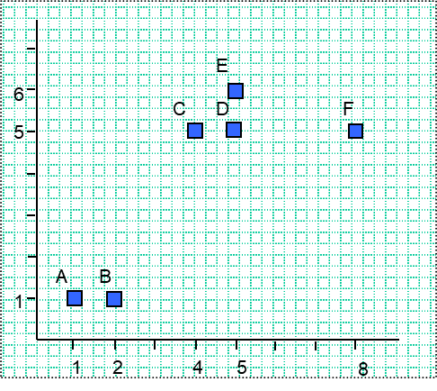
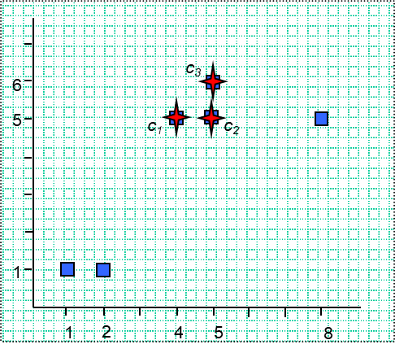
K-mean
Data set
X: a set of N data vectors
N = 6
Number of clusters
Random initial centroids
Initial codebook:
c₁ = C, c₂ = D, c₃ = E
C_{I}: initialized k cluster centroids
k = 3

Slide 15
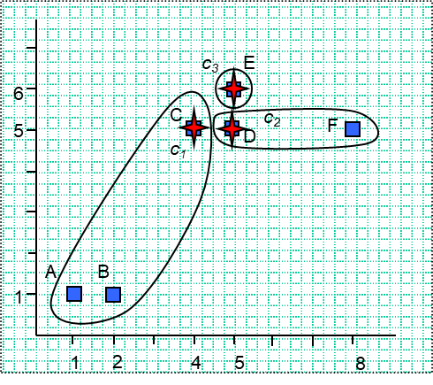
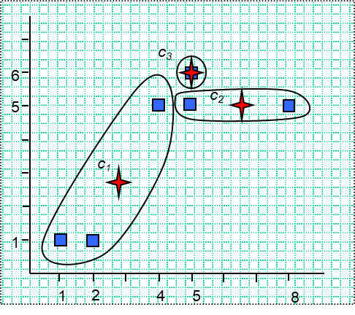
K-mean
Generate optimal partitions
Distance matrix (Euclidean distance)
A B C D E F
c₁
c₂
c₃
Generate optimal centroids.

Slide 16
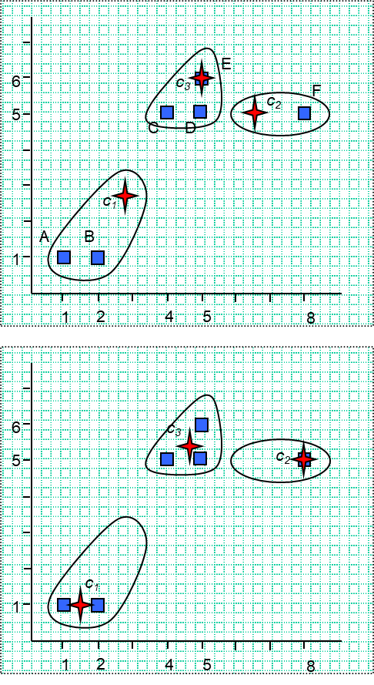
K-mean
Generate optimal partitions
Distance matrix (Euclidean distance)
A B C D E F
c₁
c₂
c₃
Generate optimal centroids

Slide 17
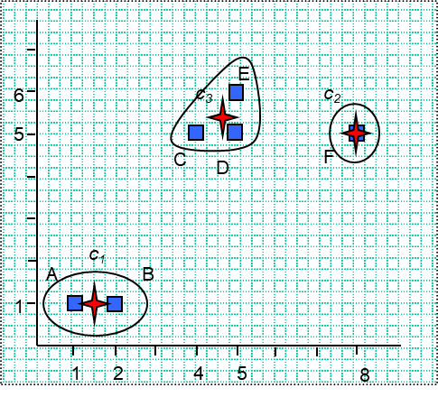
K-mean
Generate optimal partitions
Distance matrix (Euclidean distance)
A B C D E F
c₁
c₂
c₃
Converge. Centroid no longer change.
After 3rd iteration: MSE = 0.31

Slide 18
K-mean
What if we initialize in different way. Example 1
X
X
X
X
x
x
X
X
x
We may get different results.

Slide 19
K-mean
What if we initialize in different way. Example 2
X
X
x
X
X
x
x
X
X
We may get different results.

Slide 20
K-mean
What if we initialize in different way. Example 3
We may get different results.

Slide 21
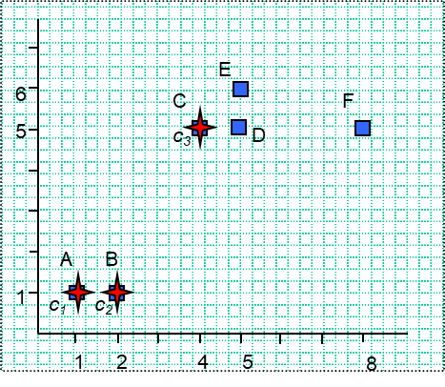
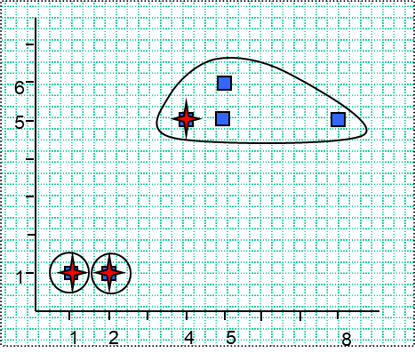
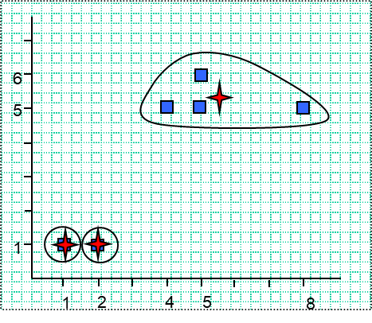
K-mean
What if we initialize in different way. Example 4
We may get different results.

Slide 22
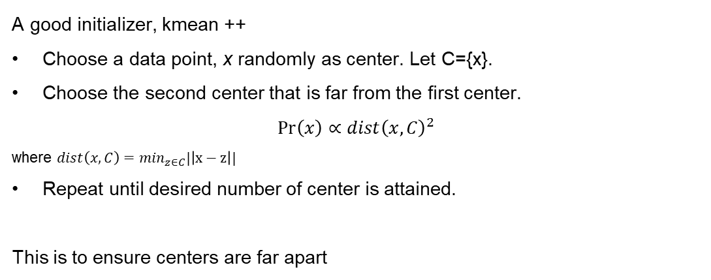
Kmean++
A good initializer, kmean ++
Choose a data point, x randomly as center. Let C={x}.
Choose the second center that is far from the first center.
$$\operatorname{Pr}\left(x\right)∝dist{\left(x, C\right)}^{2}$$
where $dist\left(x, C\right)=\min_{z∈C}|\left|x−z\right||$
Repeat until desired number of center is attained.
This is to ensure centers are far apart

Slide 23
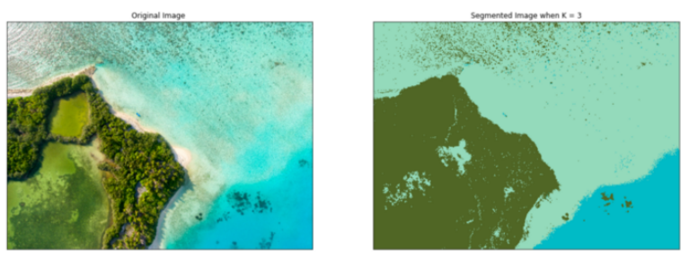
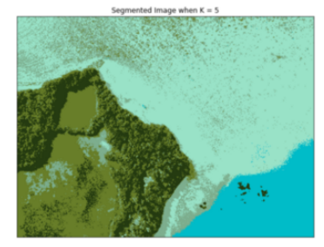
Kmean for Segmentation
K=3
K=5

Slide 24
Use case
Document Classification – cluster the document according to the terms used. Group similar document together.
Delivery store optimization - use a combination of k-means to find the optimal number of launch locations and a genetic algorithm to solve the truck route as a traveling salesman problem. Paper here.
Identifying Crime Localities
Customer Segmentation - how telecom providers can cluster pre-paid customers to identify patterns in terms of money spent in recharging, sending sms, and browsing the internet. the classification would help the company target specific clusters of customers for specific campaigns. Paper here.
https://dzone.com/articles/10-interesting-use-cases-for-the-k-means-algorithm

Slide 25
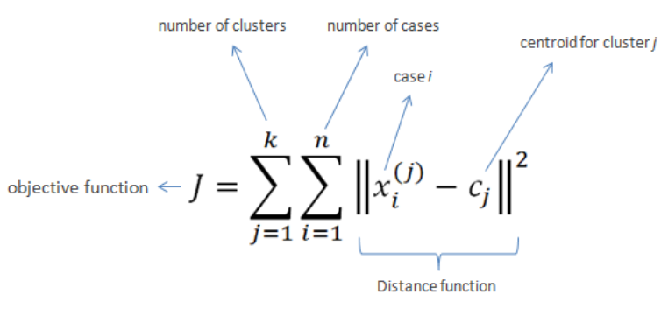
Kmean
A particularly simple method for clustering is K-means, which is identical to the LBG or generalized Lloyd algorithm we know from vector quantization, just applied to clustered data.
The idea is to represent each cluster k by a center point ck and assign each data point x_{n} to one of the clusters k, which can be written in terms of index sets C_{k}.
The center points and the assignment are then chosen such that the mean squared distance between data points and center points is minimized
Image from https://www.saedsayad.com/clustering_kmeans.htm

Slide 26
Limitation
K-means has problems when clusters are of different
Sizes
Densities
Non-globular shapes
K-means has problems when the data contains outliers.

Slide 27
Limitation – Different Size
Data point
K = 3

Slide 28
Limitation – Different Density
Data point
K = 3

Slide 29
Limitation – non globular shape
Data point
K = 2

Slide 30
To overcome k-mean limitation
Generate more cluster. Then combine similar cluster
Data point
Generate more cluster

Slide 31
To overcome k-mean limitation
Generate more cluster. Then combine similar cluster
Data point
Generate more cluster

Slide 32
To overcome k-mean limitation
Generate more cluster. Then combine similar cluster
Data point
Generate more cluster

Slide 33
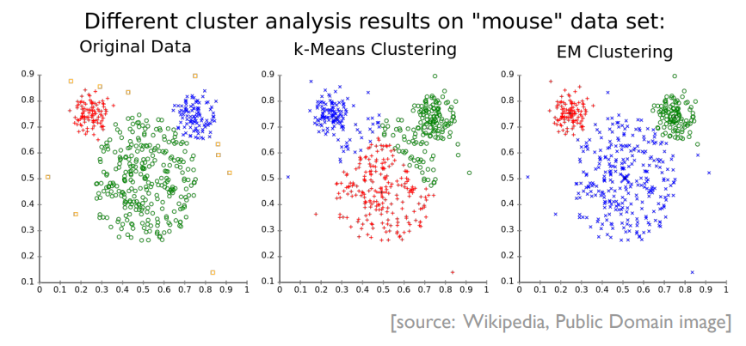
To overcome k-mean limitation
Generate more cluster. Then combine similar cluster
EM clustering using Gaussian Mixture Model
Intuition: Assume that the data generating process is a mixture of Multivariate Normals

Slide 34
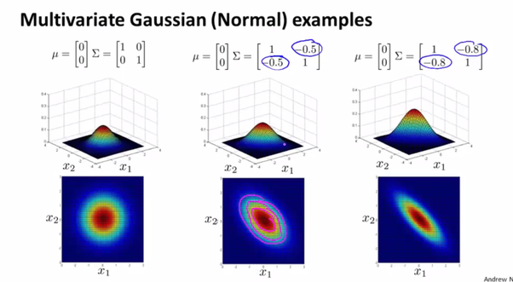
EM clustering
Assume each observation has probability π_{k} of coming from cluster k
Assume that all observations from cluster k a drawn randomly from a Multivariate Variable Normal (µ_{k}, Σ_{k}) distribution

Slide 35
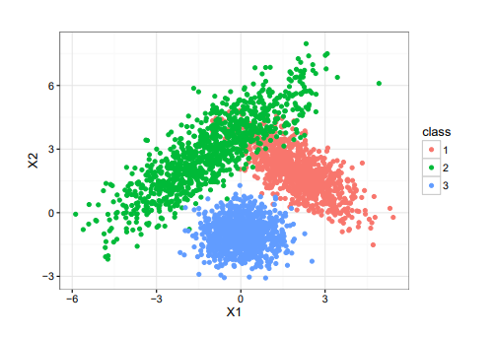
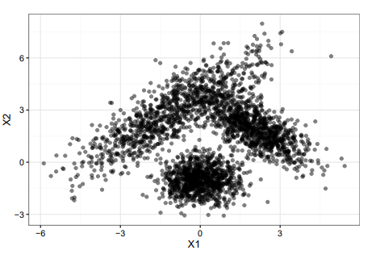
EM clustering
Ground Truth
Observation

Slide 36
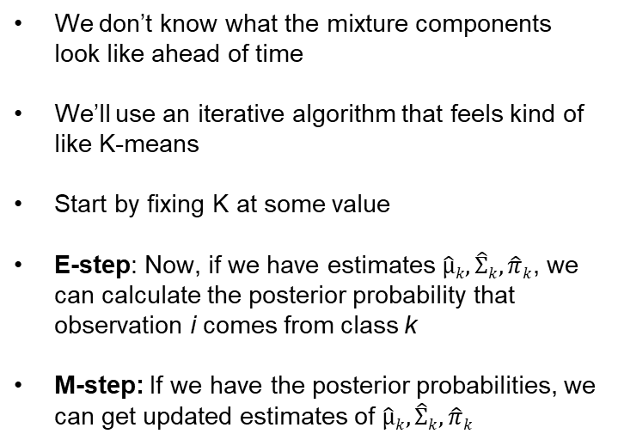
EM clustering
Observation
We don’t know what the mixture components look like ahead of time
We’ll use an iterative algorithm that feels kind of like K-means
Start by fixing K at some value
E-step: Now, if we have estimates $\hat{µ}k, \hat{Σ}k, \hat{π}k$, we can calculate the posterior probability that observation i comes from class k
M-step: If we have the posterior probabilities, we can get updated estimates of $\hat{µ}k, \hat{Σ}k, \hat{π}k$

Slide 37
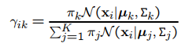
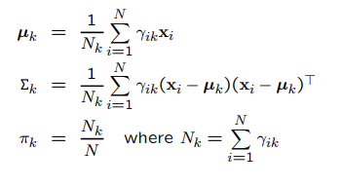
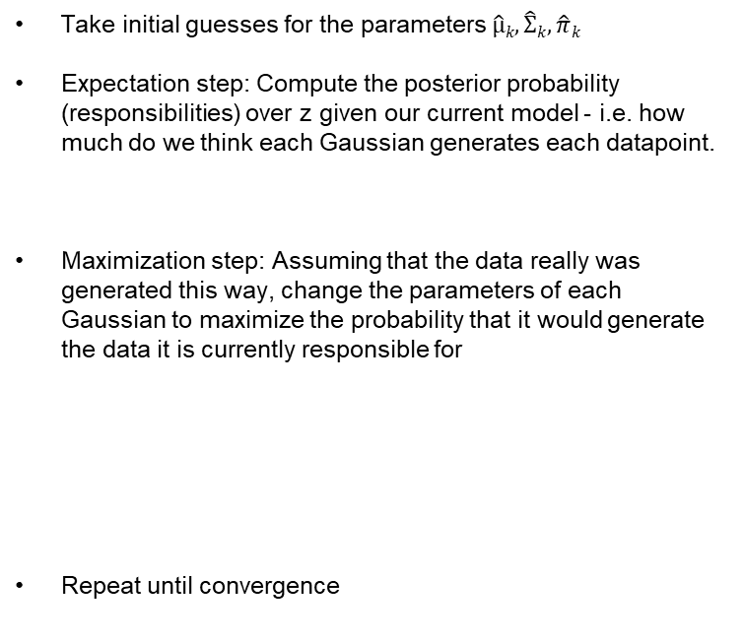
EM clustering
Take initial guesses for the parameters $\hat{µ}k, \hat{Σ}k, \hat{π}k$
Expectation step: Compute the posterior probability (responsibilities) over z given our current model - i.e. how much do we think each Gaussian generates each datapoint.
Maximization step: Assuming that the data really was generated this way, change the parameters of each Gaussian to maximize the probability that it would generate the data it is currently responsible for
Repeat until convergence
Observation

Slide 38
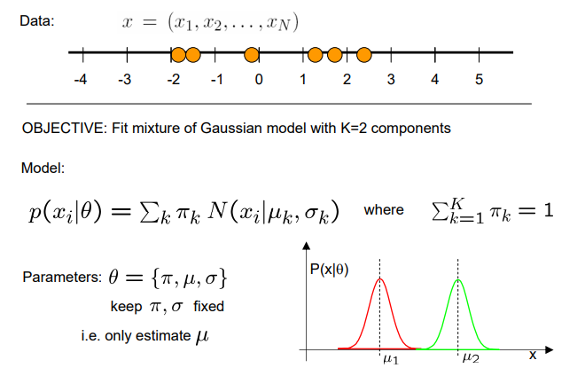
EM clustering

Slide 39
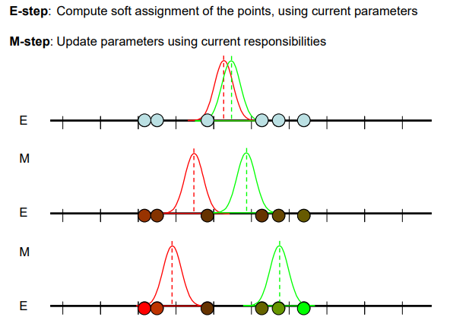
EM clustering intuition

Slide 40
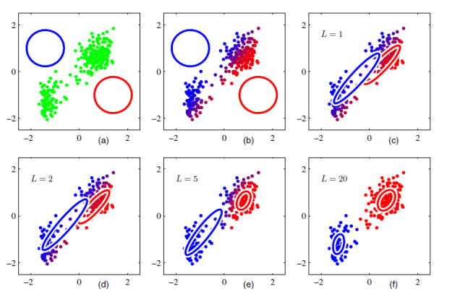
EM clustering

Slide 41
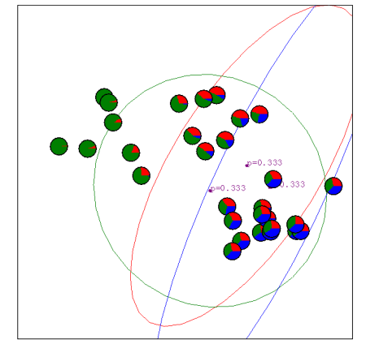
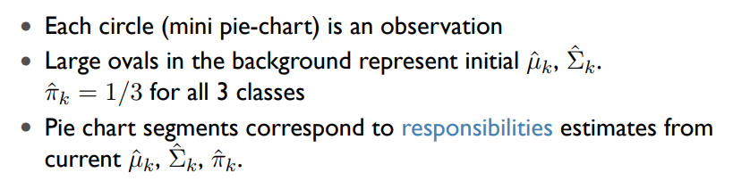
EM clustering

Slide 42
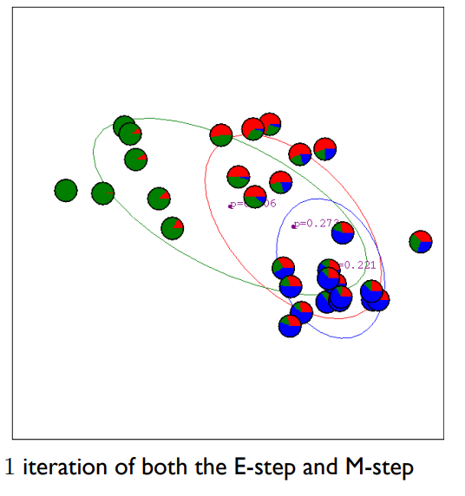
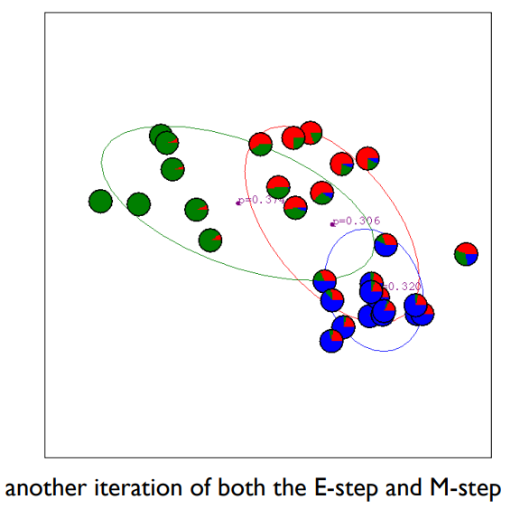
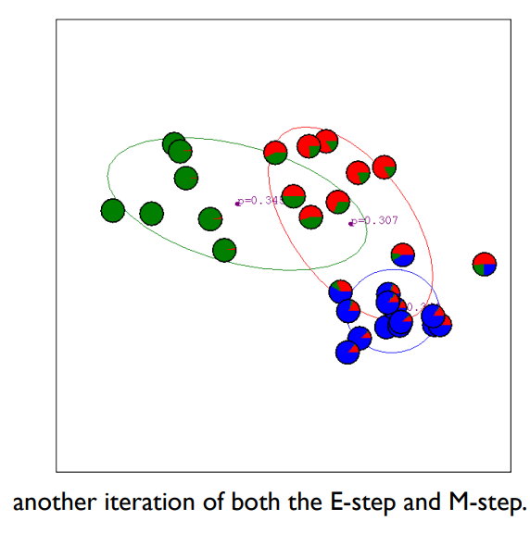
EM clustering

Slide 43
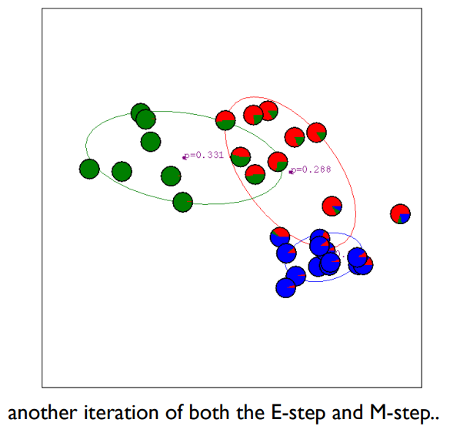
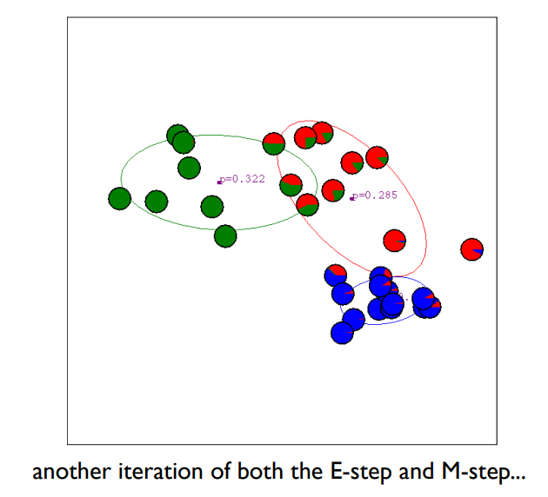
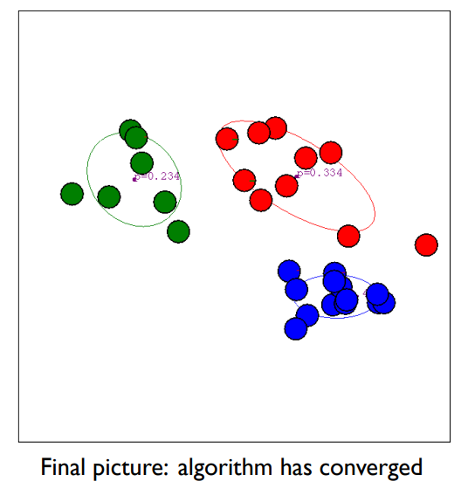
EM clustering
…

Slide 44
EM clustering
GMM’s do better on this example because they essentially allow for a data-adaptive notion of distance when assigning points to centroids
i.e., In the original data, we have 2 clumps with small variance, and one clump with large variance
K-means can’t capture this added information
GMM’s say: An observation belongs to C_{k} if its variance-adjusted (i.e., Σ_{k}-adjusted) distance to µ_{k} is small

Slide 45
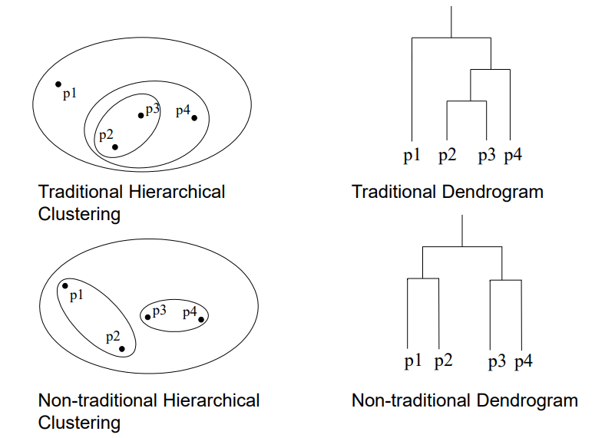
Hierarchy Clustering
Data are in nested clusters, organized in a hierarchical tree

Slide 46
Hierarchy Clustering
Agglomerative (bottom up): Initially, each point is a cluster Repeatedly combine the two “nearest” clusters into one
Divisive (top down): Start with one cluster and recursively split

Slide 47
Agglomerative (bottom up)
Each point starts as its own cluster
Merge the two clusters (points) that are closet to each other
Merge the two other clusters (points) that are closet to each other
Merge the next two close clusters
Until at last all of the points are all in a single cluster
4
5
3
1
2

Slide 48
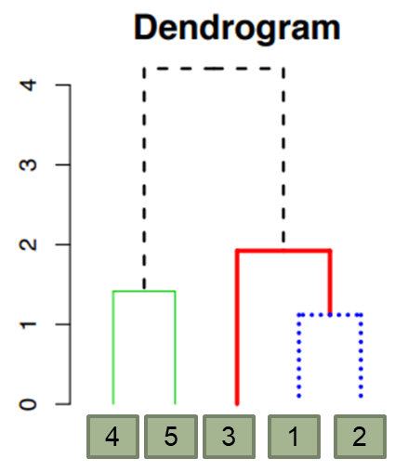
Agglomerative (bottom up)
4
5
3
1
2
Each point starts as its own cluster
y-axis on dendrogram is (proportional to) the distance between the clusters that got merged at that step

Slide 49
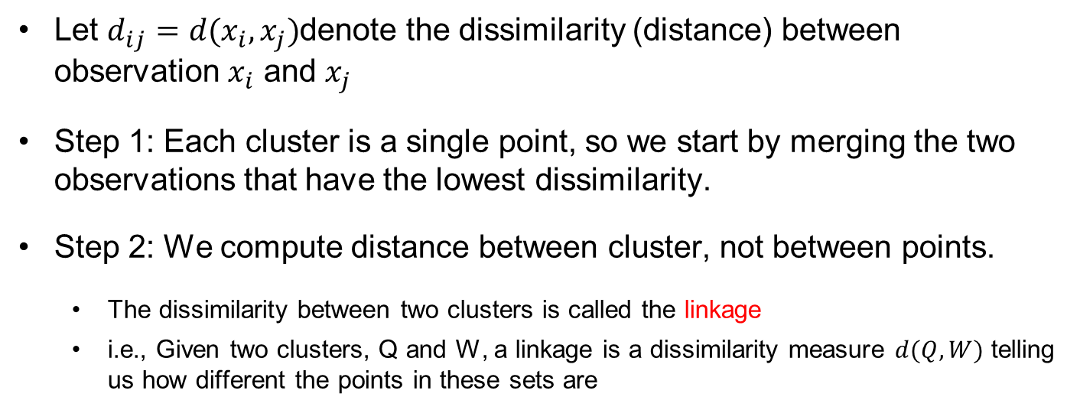
Compute dissimilarity
Let $d_{ij}=d(x_{i},x_{j})$denote the dissimilarity (distance) between observation $x_{i}$ and $x_{j}$
Step 1: Each cluster is a single point, so we start by merging the two observations that have the lowest dissimilarity.
Step 2: We compute distance between cluster, not between points.
The dissimilarity between two clusters is called the linkage
i.e., Given two clusters, Q and W, a linkage is a dissimilarity measure $d(Q, W)$ telling us how different the points in these sets are

Slide 50
Single Linkage
G
distance between the clusters that got merged at that step
B
A
F
H
D
E
C
A
B
C
D
E
F
G
H

Slide 51
Single Linkage
G
distance between the clusters that got merged at that step
B
A
F
H
D
E
C
A
B
C
D
E
F
G
H

Slide 52
Single Linkage
G
distance between the clusters that got merged at that step
B
A
F
H
D
E
C
A
B
C
D
E
F
G
H

Slide 53
Single Linkage
G
distance between the clusters that got merged at that step
B
A
F
H
D
E
C
A
B
C
D
E
F
G
H

Slide 54
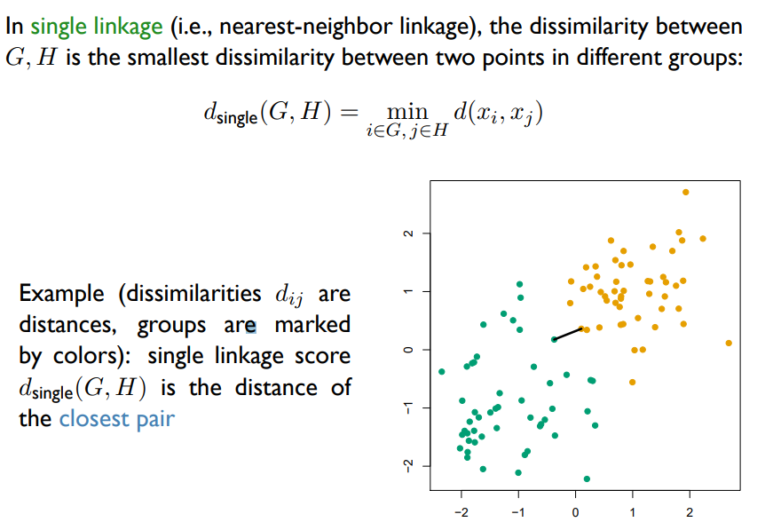
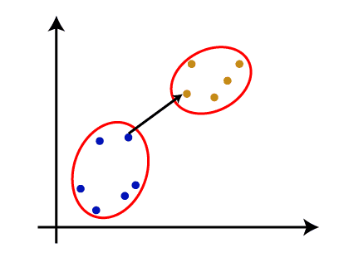
Single Linkage

Slide 55
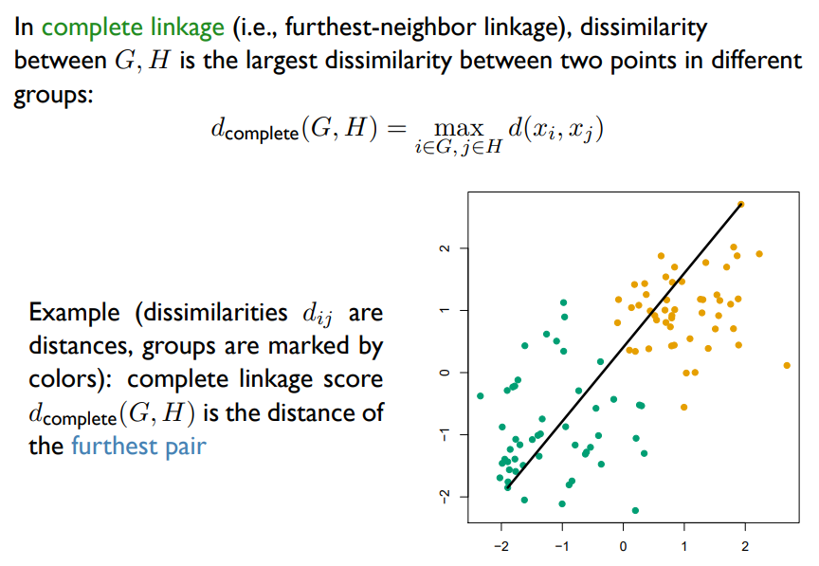
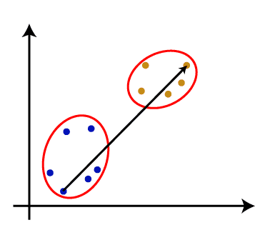
Complete Linkage

Slide 56
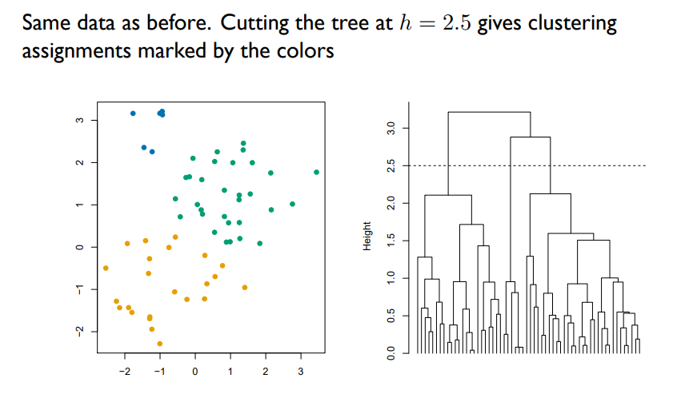
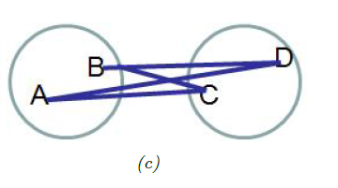
Average Linkage

Slide 57
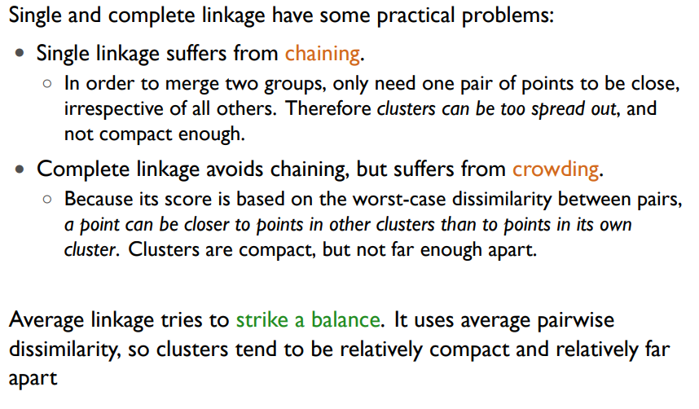
Shortcoming of Single and Complete Linkage

Slide 58
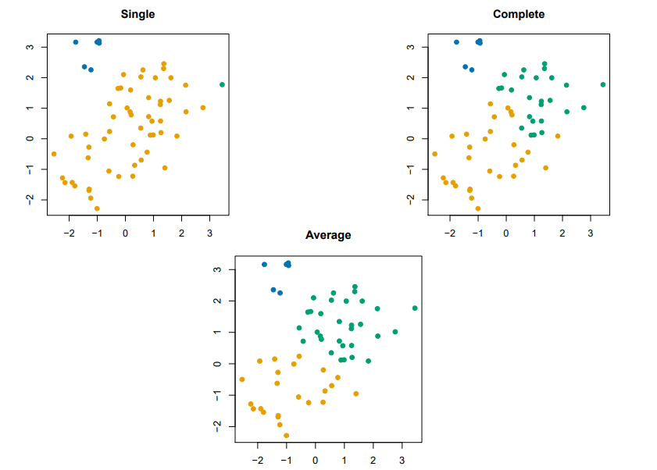
Shortcoming of Single and Complete Linkage

Slide 59
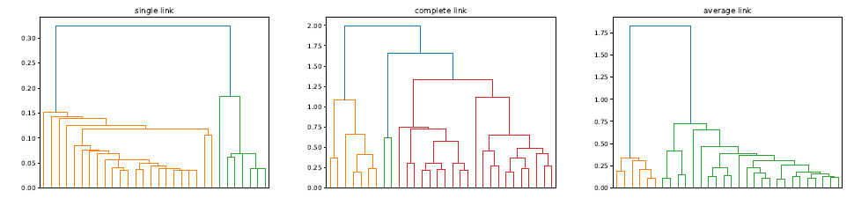
Shortcoming of Single and Complete Linkage

Slide 60

Dissimilarity measures

Slide 61


Dissimilarity measures
Image from https://www.facebook.com/photo/?fbid=10224815831330636&set=a.10200946882861842
https://www.researchgate.net/publication/328379237_Homogeneous_Densities_Clustering_Algorithm/figures?lo=1&utm_source=google&utm_medium=organic

Slide 62

Kmean vs Hierarchy

Slide 63
Data Preprocessing
Normalization – if your data has normal distribution
Log-transform – if your data has power distribution
Quantile normalization - otherwise

Slide 64

Normalization

Slide 65


Log-transform

Slide 66


Quantile

Slide 67

Principal Component Analysis (PCA)
Reduce dimension
PC component describe the largest data variance
Image from https://towardsdatascience.com/pca-clearly-explained-how-when-why-to-use-it-and-feature-importance-a-guide-in-python-7c274582c37e

Slide 68
Choosing the number of K
Elbow curve method
Silhouette analysis

Slide 69

Elbow curve method
Basic idea behind partitioning methods, such as k-means clustering, is to define clusters such that the total intra-cluster variation [or total within-cluster sum of square (WSS)] is minimized.
Y-axis plots the total WSS.
An optimal number of K = number of clusters so that adding another cluster doesn’t improve much better the total WSS.
Image from https://www.analyticsvidhya.com/blog/2021/05/k-mean-getting-the-optimal-number-of-clusters/

Slide 70



Silhouette analysis
The silhouette coefficient is a measure of how similar a data point is within-cluster (cohesion) compared to other clusters (separation).
Image from https://www.analyticsvidhya.com/blog/2021/05/k-mean-getting-the-optimal-number-of-clusters/

Slide 71


Silhouette analysis
Image from https://www.analyticsvidhya.com/blog/2021/05/k-mean-getting-the-optimal-number-of-clusters/

Slide 72

Principal Component Analysis
Mathematically, the principal components are the eigenvectors of the covariance matrix of the original dataset.
Because the covariance matrix is symmetric, the eigenvectors are orthogonal.
The principal components (eigenvectors) correspond to the direction (in the original n-dimensional space) with the greatest variance in the data.

Slide 73
Principal Component Analysis
Each eigenvector has a corresponding eigenvalue. An eigenvalue is a scalar. Recall that an eigenvector corresponds to a direction.
The corresponding eigenvalue is a number that indicates how much variance there is in the data along that eigenvector (or principal component).
In other words, a larger eigenvalue means that that principal component explains a large amount of the variance in the data.
A principal component with a very small eigenvalue does not do a good job of explaining the variance in the data.
In the extreme case, if a principal component had an eigenvalue of zero, then it would mean that it explained none of the variance in the data.

Slide 74
Maths behind PCA - Example
Step 1: Standardize the dataset.
Step 2: Calculate the covariance matrix for the features in the dataset.
Step 3: Calculate the eigenvalues and eigenvectors for the covariance matrix.
Step 4: Sort eigenvalues and their corresponding eigenvectors.
Step 5: Pick k eigenvalues and form a matrix of eigenvectors.
Step 6: Transform the original matrix.
Credit to https://medium.com/analytics-vidhya/understanding-principle-component-analysis-pca-step-by-step-e7a4bb4031d9

Slide 75




Maths behind PCA - Example
Step 1: Standardize the dataset.
Credit to https://medium.com/analytics-vidhya/understanding-principle-component-analysis-pca-step-by-step-e7a4bb4031d9

Slide 76



Maths behind PCA - Example
Step 2: Calculate the covariance matrix for the features in the dataset.
$$cov\left(f1, f1\right)=\frac{1}{n}\sum{(f1−\overline{f1})(f1−\overline{f1})}$$
$$\frac{{(−1)}^{2}+{0.33}^{2}+{\left(−1\right)}^{2}+{0.33}^{2}+{1.33}^{2}}{5}=0.8$$
$$cov mat=\left[\begin{matrix}\begin{matrix}0.8 \\ \\ \end{matrix} & \begin{matrix} & & \\ & & \\ & & \end{matrix} \\ & \begin{matrix} & & \end{matrix}\end{matrix}\right]$$
Credit to https://medium.com/analytics-vidhya/understanding-principle-component-analysis-pca-step-by-step-e7a4bb4031d9

Slide 77



Maths behind PCA - Example
Step 2: Calculate the covariance matrix for the features in the dataset.
$$cov\left(f2, f2\right)=\frac{1}{n}\sum{(f2−\overline{f2})(f2−\overline{f2})}$$
$$\frac{{(−0.63)}^{2}+{1.26}^{2}+{0.63}^{2}+0^{2}+{(−1.26)}^{2}}{5}=0.8$$
$$cov mat=\left[\begin{matrix}\begin{matrix}0.8 \\ \\ \end{matrix} & \begin{matrix} & & \\ 0.8 & & \\ & & \end{matrix} \\ & \begin{matrix} & & \end{matrix}\end{matrix}\right]$$
Credit to https://medium.com/analytics-vidhya/understanding-principle-component-analysis-pca-step-by-step-e7a4bb4031d9

Slide 78


Maths behind PCA - Example
Step 2: Calculate the covariance matrix for the features in the dataset.
$$Repeat the rest for diagonal$$
$$cov mat=\left[\begin{matrix}\begin{matrix}0.8 \\ \\ \end{matrix} & \begin{matrix} & & \\ 0.8 & & \\ & 0.8 & \end{matrix} \\ & \begin{matrix} & & 0.8\end{matrix}\end{matrix}\right]$$
Credit to https://medium.com/analytics-vidhya/understanding-principle-component-analysis-pca-step-by-step-e7a4bb4031d9

Slide 79


Maths behind PCA - Example
Step 2: Calculate the covariance matrix for the features in the dataset.
$$cov\left(f1, f2\right)=\frac{1}{n}\sum{(f1−\overline{f1})(f2−\overline{f2})}$$
$$=\frac{(−1)(−0.63)+(0.33)(1.26)+(−1)(0.63)+0+(1.33)(−1.26)}{5}=−0.25$$
$$cov mat=\left[\begin{matrix}\begin{matrix}0.8 \\ −0.25 \\ \end{matrix} & \begin{matrix}−0.25 & & \\ 0.8 & & \\ & 0.8 & \end{matrix} \\ & \begin{matrix} & & 0.8\end{matrix}\end{matrix}\right]$$
Credit to https://medium.com/analytics-vidhya/understanding-principle-component-analysis-pca-step-by-step-e7a4bb4031d9

Slide 80



Maths behind PCA - Example
Step 2: Calculate the covariance matrix for the features in the dataset.
$$cov\left(f1, f3\right)=\frac{1}{n}\sum{(f1−\overline{f1})(f3−\overline{f3})}$$
$$=\frac{(−1)(0)+(0.33)(1.73)+(−1)(−0.58)+(0.33)(−0.58)+(1.33)(−0.58)}{5}=0.04$$
$$cov mat=\left[\begin{matrix}\begin{matrix}0.8 \\ −0.25 \\ 0.04\end{matrix} & \begin{matrix}−0.25 & 0.04 & \\ 0.8 & & \\ & 0.8 & \end{matrix} \\ & \begin{matrix} & & 0.8\end{matrix}\end{matrix}\right]$$
Credit to https://medium.com/analytics-vidhya/understanding-principle-component-analysis-pca-step-by-step-e7a4bb4031d9

Slide 81


Maths behind PCA - Example
Step 2: Calculate the covariance matrix for the features in the dataset.
$$Repeat the rest$$
$$cov mat=\left[\begin{matrix}\begin{matrix}0.8 \\ −0.25 \\ 0.04\end{matrix} & \begin{matrix}−0.25 & 0.04 & −0.14 \\ 0.8 & 0.51 & 0.49 \\ 0.51 & 0.8 & 0.75\end{matrix} \\ −0.14 & \begin{matrix}0.49 & 0.75 & 0.8\end{matrix}\end{matrix}\right]$$
Credit to https://medium.com/analytics-vidhya/understanding-principle-component-analysis-pca-step-by-step-e7a4bb4031d9

Slide 82



Maths behind PCA - Example
Step 3: Calculate the eigenvalues and eigenvectors for the covariance matrix.
Solve for $det\left(λI−A\right)=0$ to find eigenvalues.
Solve the system to find eigenvector
$$λ=2.01263459, 0.8522308, 0.31510964, 0.02002497$$
Credit to https://medium.com/analytics-vidhya/understanding-principle-component-analysis-pca-step-by-step-e7a4bb4031d9

Slide 83




Maths behind PCA - Example
Step 3: Calculate the eigenvalues and eigenvectors for the covariance matrix.
Solve for $det\left(λI−A\right)=0$ to find eigenvalues.
Solve the system to find eigenvector
Eigenvectors for λ=2.01263459
$$λ=2.01263459$$
Credit to https://medium.com/analytics-vidhya/understanding-principle-component-analysis-pca-step-by-step-e7a4bb4031d9

Slide 84

Maths behind PCA - Example
Step 3: Calculate the eigenvalues and eigenvectors for the covariance matrix.
Solve for $det\left(λI−A\right)=0$ to find eigenvalues.
Solve the system to find eigenvector
Repeat the same for all eigenvalues, we get the following
$$λ=2.01263459, 0.8522308, 0.31510964, 0.02002497$$
v1
v2
v3
v4
Credit to https://medium.com/analytics-vidhya/understanding-principle-component-analysis-pca-step-by-step-e7a4bb4031d9

Slide 85
Maths behind PCA - Example
Remember that: larger eigenvalue means that that principal component explains a large amount of the variance in the data.
The first principal component accounts for the largest possible variance in the dataset.

Slide 86
Maths behind PCA - Example
Step 4: Sort eigenvalues and their corresponding eigenvectors.
$$λ=2.01263459, 0.8522308, 0.31510964, 0.02002497$$
v1
v2
v3
v4
Credit to https://medium.com/analytics-vidhya/understanding-principle-component-analysis-pca-step-by-step-e7a4bb4031d9

Slide 87
Maths behind PCA - Example
Step 5: Pick k eigenvalues and form a matrix of eigenvectors.
Let say, we take k = 4
Credit to https://medium.com/analytics-vidhya/understanding-principle-component-analysis-pca-step-by-step-e7a4bb4031d9

Slide 88




Maths behind PCA - Example
Step 6: Transform the original matrix to principal component space.
Original Matrix * Top 4 eigenvector matrix = Transformed matrix
$S∙V=P$
$$=$$

Slide 89



Maths behind PCA - Example
To transform back to original space
$$S=P∙V^{−1}$$
-1
$$∙$$
$$=$$

Slide 90

Maths behind PCA - Example
To transform back to original space: * std + mean
$$S∗std+mean$$

Slide 91
Maths behind PCA - Example
Another Scenario, k = 2

Slide 92


Maths behind PCA - Example
Step 6: Transform the original matrix to principal component space.
Original Matrix * Top 2 eigenvector matrix = Transformed matrix
$S∙V=P$
Credit to https://medium.com/analytics-vidhya/understanding-principle-component-analysis-pca-step-by-step-e7a4bb4031d9

Slide 93

Compare with sklearn library
Credit to https://medium.com/analytics-vidhya/understanding-principle-component-analysis-pca-step-by-step-e7a4bb4031d9

Slide 94

Applications
Clustering Algorithm
Image from https://medium.com/analytics-vidhya/understanding-principle-component-analysis-pca-step-by-step-e7a4bb4031d9

Slide 95
Applications
PCA has been used on Medical Data to show correlation of Cholesterol with low density lipo-protein.
PCA has been used on HVSR(horizontal to vertical spectral ratio) data aimed at the seismic characterization of earthquake prone areas.
PCA has been used in the Detection and Visualization of Computer Network Attacks.
PCA has been used in Anomaly Detection

Slide 96
Move to colab

Slide 97
Credit to the following sources:
https://www.ini.rub.de/PEOPLE/wiskott/Teaching/Material/Clustering-LectureNotesPublicVideoAnnotated.pdf
https://www.aryabhattacollege.ac.in/samplepaper/637202999310007925DataMining1.pdf
https://www.andrew.cmu.edu/user/achoulde/95791/lectures/lecture07/lecture07_95791.pdf
https://inblog.in/Hierarchical-Clustering-and-Density-Based-Spatial-Clustering-of-Applications-with-Noise-DBSCAN-DbGMBttoOD
https://www.robots.ox.ac.uk/~az/lectures/ml/2011/lect8.pdf

